Slide 1
Design Patterns Using OpenEdge

Slide 2

Audience for this course
This course is for experienced ABL developers who have a good understanding of Object Oriented development and want to achieve a higher level of software quality from design to development, maintenance and deployment.

Slide 3
Course prerequisites
Before you begin this course, you should have experience with:
Basic Object Oriented understanding from a developer’s point of view
Writing ABL code to:
Create simple abstract classes and interfaces
Create simple concrete classes
Developer Studio for OpenEdge to create projects, procedures, classes and edit ABL code.
Progress Application server for OpenEdge (PAS for OpenEdge)
Modifying a launch configuration
Starting and stopping a PAS for OpenEdge instance

Slide 4
Introduce yourself
Your name and your job.
Name of your company and its type of business.
Your technical background.
Any prior experience with Progress Software products?
What would you like to learn from this course?

Slide 5
Learning objectives for this course
After taking this class, you should be able to:
Understand and explain each design principle presented.
Have a more profound and concise understanding of key object oriented concepts.

Slide 6
System and software requirements for this course
Hardware/platform
Windows 64 bit
2 Gb RAM
100 Mb disk space for course files
6 Gb disk space for Progress OpenEdge install files and installation
Progress Developer Studio for OpenEdge 11.7 or later
Must install 64 bit version of Developer Studio with one of:
Developer Studio for OpenEdge license
OpenEdge Developer Kit (OEDK) Classroom Edition (no license required)
See ExerciseSetup for instructions to follow before you begin the exercises of this course

Slide 7
Agenda
Key Object Oriented Concepts
Why Design Patterns?
Creational Patterns
Structural Patterns
Behavioral Patterns

Slide 8
Key Object Oriented Concepts
Classes, Subclasses, Types and Subtypes
Interfaces, Abstract and Concrete Classes
Abstraction and Implementation
Inheritance and Composition
Encapsulation: members can be private, protected, public, static
Dynamic Binding and Polymorphism (LSP)
S <: T
Object Oriented Design
Notes:
How to decompose a system into objects. Nouns and verbs, real world objects etc.
Substitutability S <: T

Slide 9
What Are Design Patterns?
Proven ways of designing and developing object oriented applications so that they become highly reusable and flexible
Based on design principles they favor composition over inheritance, try to maximize OCP, SRP and all the others
Made possible mostly since S <: T
Class patterns vs. object patterns
Class patterns use inheritance
Object patterns rely on composition

Slide 10
Why Design Patterns?
Promote communication
Stimulate new ideas
Education (everybody else is doing it)
Achieve higher levels of:
Encapsulation
Granularity
Dependency (less, that is)
Flexibility
Performance
Evolution
Reusability
Maintenance
Deployment (release process)
Notes:
“Designing object-oriented software is hard, and designing reusable object-oriented software is even harder. You must find pertinent objects, factor them into classes at the right granularity, define class interfaces and inheritance hierarchies, and establish key relationships among them. Your design should be specific to the problem at hand but also general enough to address future problems and requirements.”
Excerpt From: Erich Gamma, Richard Helm, Ralph Johnson & John M. Vlissides. “Design Patterns: Elements of Reusable Object-Oriented Software.”

Slide 11
Types of Design Patterns
Creational
Facilitate, or otherwise automate or abstract, the creation (or instantiation) of objects for a given purpose or application
Structural
Use classes and objects to create certain structures whose goal is to solve certain problems
Behavioral
Help create and organize algorithms (behavior or logic) and the communication between objects

Slide 12
Creational Patterns
Abstract Factory
Builder
Factory Method
Singleton
Notes:
“Creational design patterns abstract the instantiation process. They help make a system independent of how its objects are created, composed, and represented. A class creational pattern uses inheritance to vary the class that’s instantiated, whereas an object creational pattern will delegate instantiation to another object.”
Excerpt From: Erich Gamma, Richard Helm, Ralph Johnson & John M. Vlissides. “Design Patterns: Elements of Reusable Object-Oriented Software.”

Slide 13
Abstract Factory
Provides an interface for creating families of related or dependent objects without specifying their concrete classes
Use of this pattern makes it possible to interchange concrete implementations without changing the code that uses them, even at runtime. This applies to both specific objects as well as the factories themselves
May result in extra initial code
Two main concepts:
Factory: creates product objects
Product: object created by factory

Slide 14
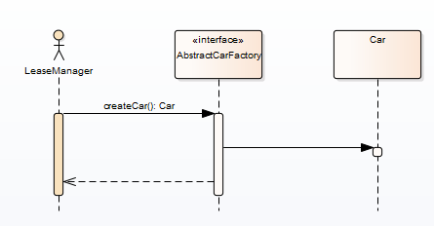
Abstract Factory — Configuration
A client uses an abstract factory
Concrete factory determined at runtime e.g. configuration or user input
The factory instantiates the objects as required by client

Slide 15
Abstract Factory — Exercise
See Exercises folder, exercise 5
See Bonus Exercise DesignPatternsOpenedge.AbstractFactory

Slide 16
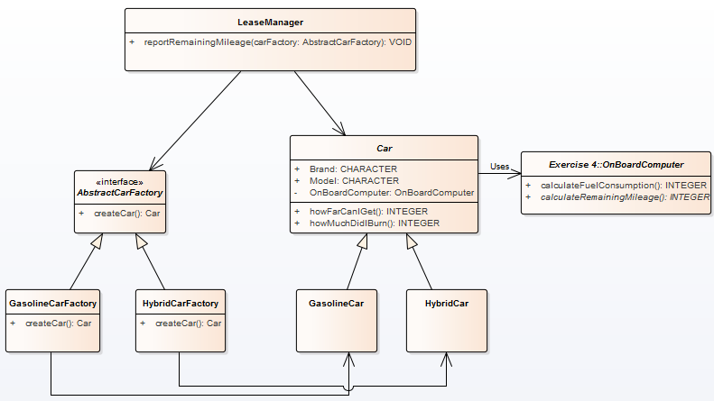
Abstract Factory — Exercise Class Diagram

Slide 17
Abstract Factory — Exercise Bonus
New requirement: lease manager now needs to be able to lease electric cars
Extend application to fulfill new requirement without affecting lease manager
Update class diagram (design)
Write new classes (develop)

Slide 18
Builder
Builder pattern builds a complex object using simple objects with a step by step approach
When and why
Complex objects
Multiple ways to instantiate a complex object
Solves the telescoping constructor anti-pattern
Create an empty object then set its attributes
Two main concepts:
Factory: creates product objects
Product: object created by factory
Notes:
The client doesn’t know which constructor to choose. Merely just looks like a bunch of strings, some don’t need to be filled and others do
Second example means the client has knowledge about the internals of the class. Also, after construction the object is not ‘finished’ yet.

Slide 19
Builder — Configuration
An abstract builder
Concrete builders for each specific product (object) — they subclass the abstract builder
Product's constructor (method) receives the concrete builder as its super type (abstract builder)
Client instantiates desired builder and asks it for product

Slide 20
Builder — Exercise
See Exercises folder, exercise 6
See Bonus Exercise DesignPatternsOpenedge.Builder

Slide 21
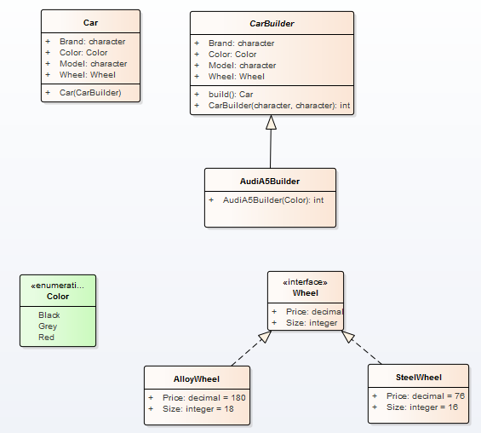
Builder — Exercise Class Diagram

Slide 22
Factory Method
Defines an interface for creating an object but let subclasses decide which class to instantiate
Lets a class defer instantiation it uses to subclasses
A.k.a. Virtual Constructor
Allows the subclasses to choose the type of objects to create
Promotes loose coupling by eliminating the need to bind application specific classes into the main client code
Client code interacts solely with the resultant interface or abstract class so that it will work with any classes that implement the interface or extend the abstract class
One of the most commonly used patterns
Delegate the construction to a specific factory or a generic factory

Slide 23
Factory Method — Exercise
See Exercises folder, exercises 7 A and 7B
See Bonus Exercise DesignPatternsOpenedge.FactoryMethod

Slide 24
Singleton
Restricts the instantiation of a class to one object
An implementation of the singleton pattern must, therefore:
ensure that only one instance of the singleton class ever exists
provide global access to that instance
Typically, this is done by:
declaring all constructors of the class to be private
providing a static method that returns a reference to the instance

Slide 25
Singleton — Exercise
See Exercises folder, exercise 8
See Bonus Exercise DesignPatternsOpenedge.Singleton

Slide 26
Structural Patterns
Adapter
Bridge
Composite
Decorator
Façade
Flyweight
Proxy
Notes:
“Structural patterns are concerned with how classes and objects are composed to form larger structures. ”
Excerpt From: Erich Gamma, Richard Helm, Ralph Johnson & John M. Vlissides. “Design Patterns: Elements of Reusable Object-Oriented Software.” Apple Books. https://books.apple.com/us/book/design-patterns-elements-reusable-object-oriented-software/id401430102

Slide 27
Adapter
A.k.a. Wrapper
Often an existing class cannot be reused because its interface does not conform to the interface a client requires and changing it is not possible or desirable
A separate Adapter class converts the (incompatible) interface of a class (Adaptee) into another interface (Target) the client can use
Use Adapter to work with, i.e. reuse, a class that does not have the required interface

Slide 28
Adapter — Exercise
See Exercises folder, exercise 9 A
See Bonus Exercise DesignPatternsOpenedge.Adapter.Cycling (picture and class diagram on two next pages)
See Bonus Exercise DesignPatternsOpenedge.Adapter.Editor

Slide 29
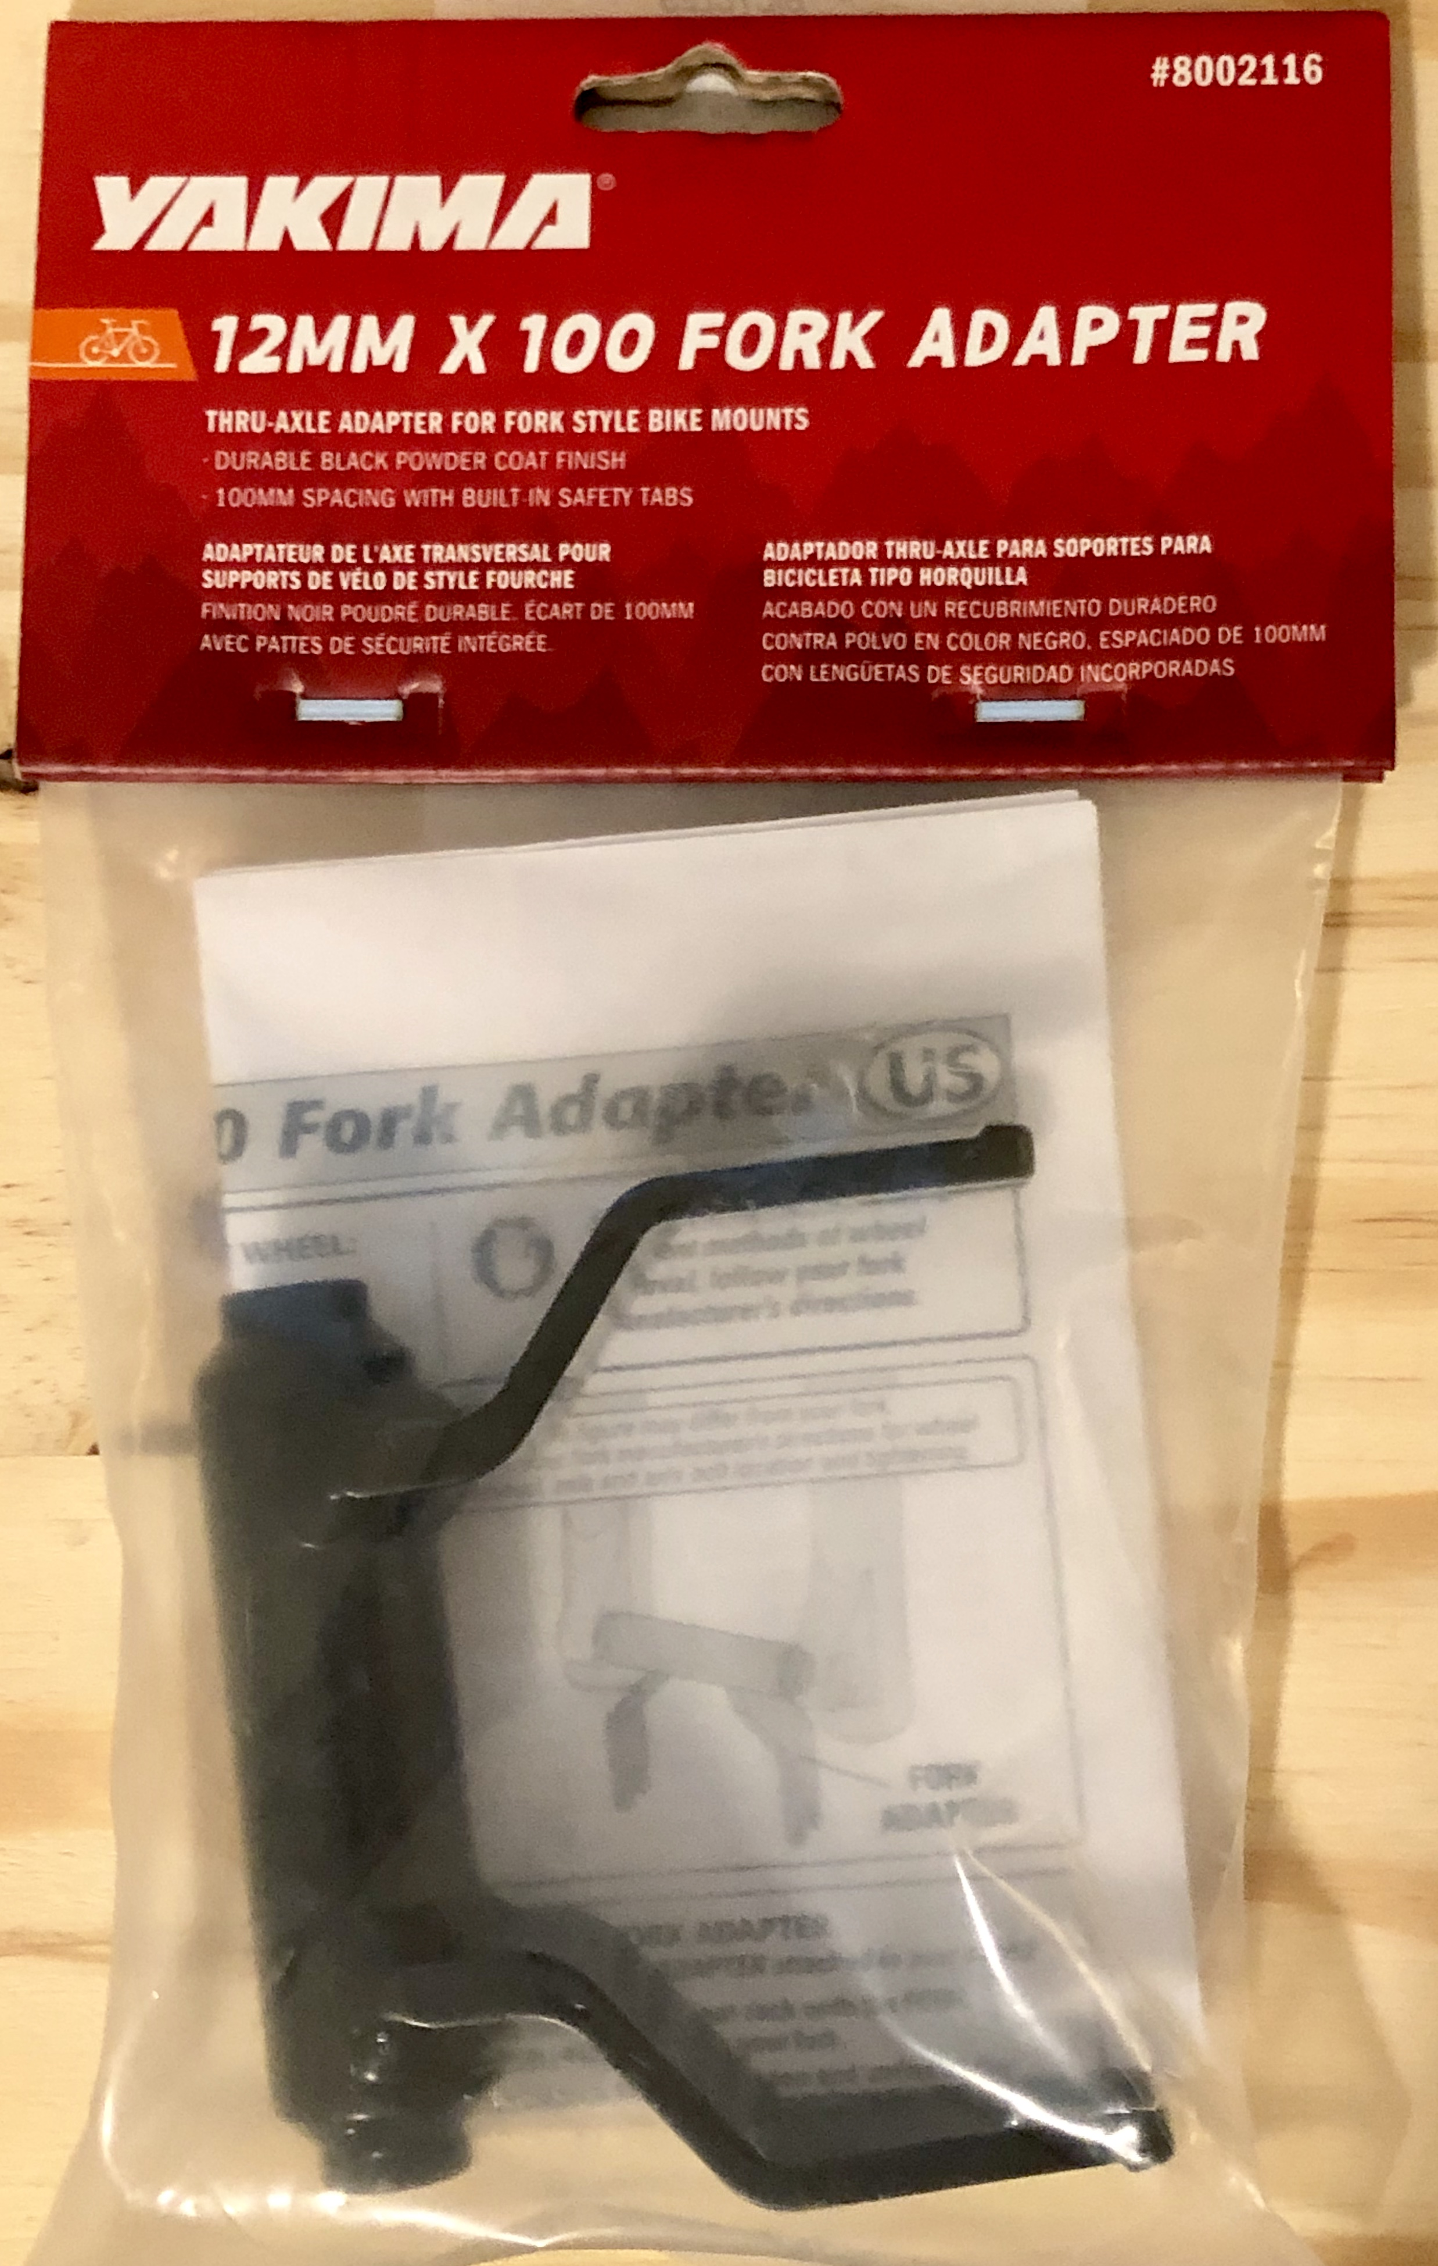


Adapter — Bonus Example

Slide 30
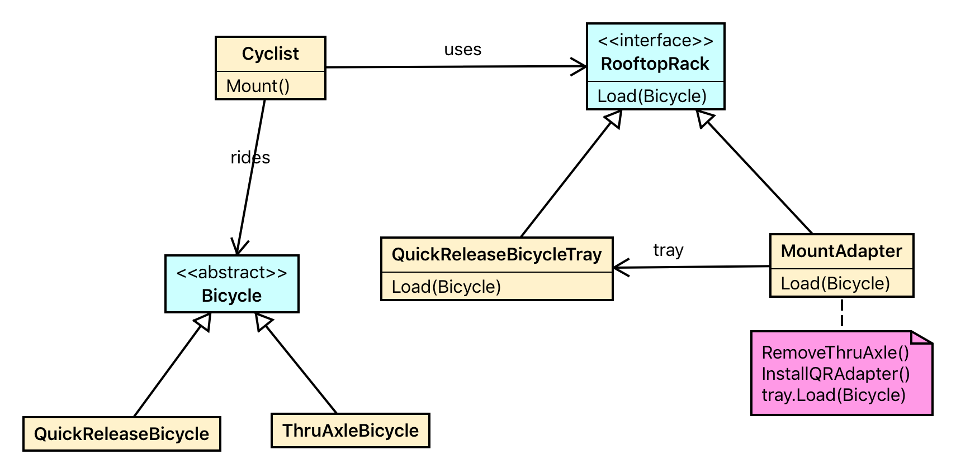

Slide 31
Bridge
Decouple an abstraction from its implementation so that the two can vary independently
Like Adapter but by design
Change implementations without affecting client, without recompile
Allow selecting and/or switching an implementation at run-time
Solve “nested generalizations” — proliferation of classes or excess subclassing

Slide 32
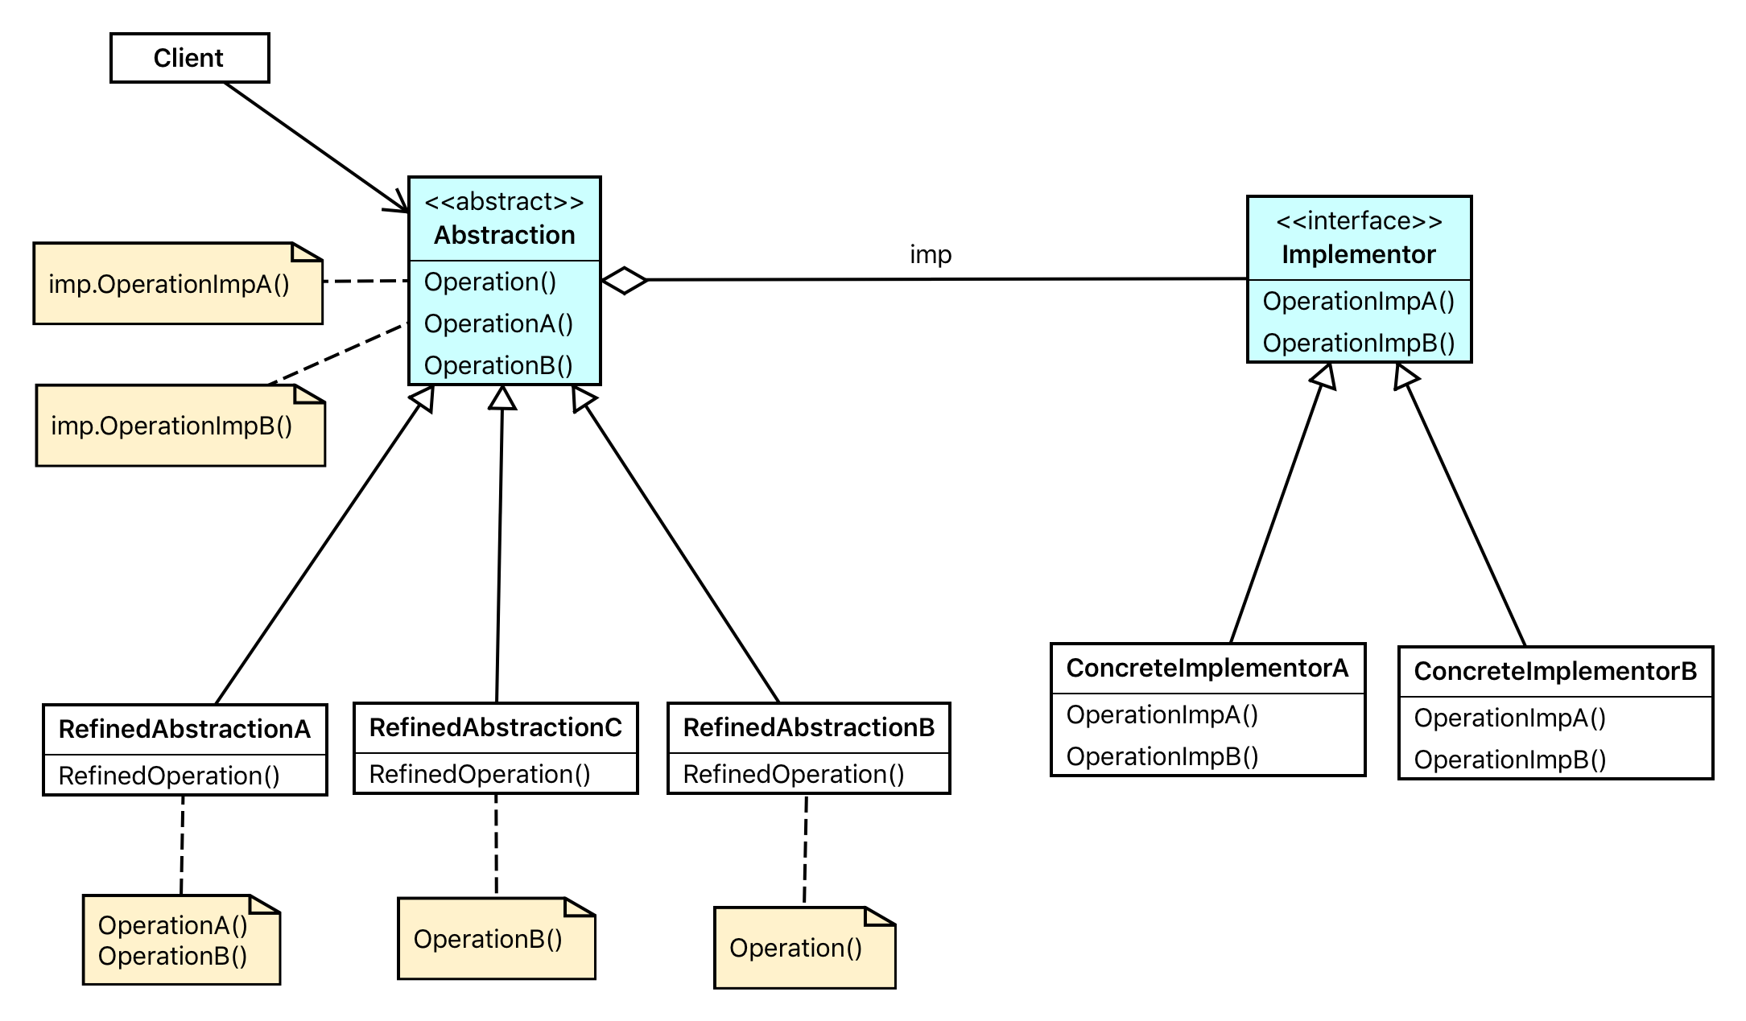
Bridge

Slide 33
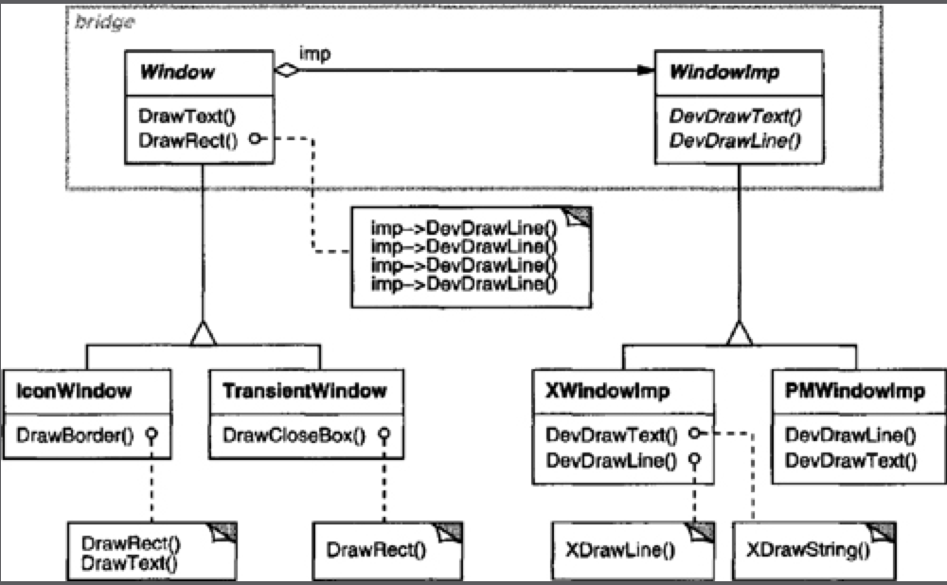
Bridge — Exercise
See Bonus Exercise DesignPatternsOpenedge.Bridge (class diagram below)

Slide 34
Composite
The composite pattern describes a group of objects that is treated the same way as a single instance of the same type of object
The intent of a composite is to “compose” objects into tree structures to represent part-whole hierarchies
Implementing the composite pattern lets clients treat individual objects and compositions uniformly

Slide 35
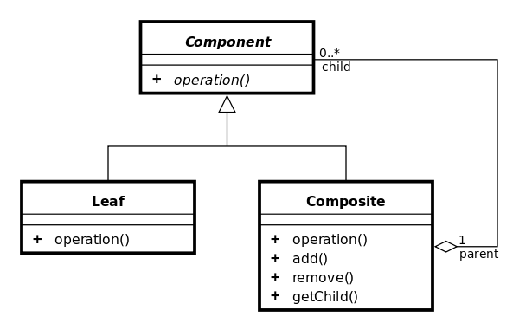
Composite — Configuration

Slide 36
Composite Operations
Where should the specific Composite operations (e.g. add) reside in?
The Component interface?
A Component abstract class?
The Composite class?

Slide 37
Composite — Exercise
See Exercises folder, exercise 10

Slide 38
Decorator
Decorator is an alternative to subclassing
Subclassing is bound to the class at compile time
… and affects ALL instances of the original class
A decorator can do this at run time
… for selective objects
“Decorates" an object with additional behavior determined at run time
Uses object composition instead of subclassing

Slide 39
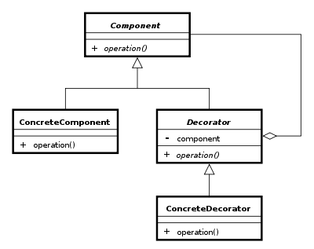
Decorator — Configuration
Subclass the original Component class into a Decorator class (see UML diagram);
In the Decorator class, add a Component pointer as a field;
In the Decorator class, pass a Component to the Decorator constructor to initialize the Component pointer;
In the Decorator class, forward all Component methods to the Component pointer; and
In the ConcreteDecorator class, override any Component method(s) whose behavior needs to be modified.
In OO ABL this “decoration” looks like: NEW MenuBranch(NEW MenuElement("Root"))

Slide 40
Decorator — Exercise
See Exercises folder, exercise 11

Slide 41
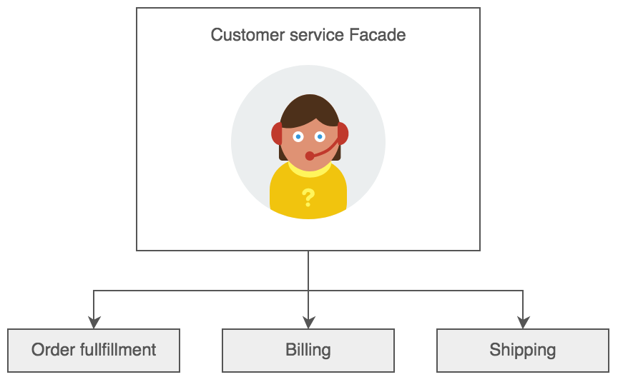
Façade
Provides a unified interface to a set of interfaces in a subsystem. Façade defines a higher-level interface that makes the subsystem easier to use
Designed from the user perspective or use case
Could be a singleton
Typically wraps multiple objects

Slide 42
Façade — Exercise
See Exercises folder, exercise 12

Slide 43
Flyweight
Flyweight is a structural design pattern that lets you fit more objects into the available amount of RAM by sharing common parts of object state among multiple objects, instead of keeping it in each object
An object has
Intrinsic state: unchangeable data
Extrinsic state: variable, context-specific, object data
Example:
Create an object for every record in the database: results in thousands of objects
Instead, create a Business Entity that holds a dataset with all records

Slide 44
Proxy
A Proxy is a class functioning as an interface to something else
A proxy is a wrapper or agent object that is being called by the client to access the real serving object behind the scene
E.g. a client-side object that calls its representative object on the server
You will use this in Exercise 13 to call logic on an AppServer

Slide 45
Behavioral Patterns
Chain of Responsibility
Command
Interpreter
Iterator
Mediator
Memento
Observer
State
Strategy
Template Method
Visitor
Notes:
“Behavioral patterns are concerned with algorithms and the assignment of responsibilities between objects. Behavioral patterns describe not just patterns of objects or classes but also the patterns of communication between them. These patterns characterize complex control flow that’s difficult to follow at run-time. They shift your focus away from flow of control to let you concentrate just on the way objects are interconnected.”
Excerpt From: Erich Gamma, Richard Helm, Ralph Johnson & John M. Vlissides. “Design Patterns: Elements of Reusable Object-Oriented Software.” Apple Books. https://books.apple.com/us/book/design-patterns-elements-reusable-object-oriented-software/id401430102

Slide 46
Chain of Responsibility
A series of processing objects
Based on Command objects
Could become a Tree of Responsibility, e.g. An XML interpreter

Slide 47
Command
Challenge: need to issue requests to objects without knowing anything about the operation being requested or the receiver of the request
The client that creates a command is not the same client that executes it
Command can use Memento to maintain the state required for an undo-operation
Two important aspects of the Command pattern: interface separation (the invoker is isolated from the receiver), time separation (stores a ready-to-go processing request to be started later — and even somewhere else when using Proxy)

Slide 48
Proxy, Chain, Command — Exercise
See Exercises folder, exercise 13

Slide 49
Interpretor
Provides a way to evaluate language grammar or expression
E.g. SQL parsing, Rules engine, Domain Specific Language

Slide 50
Iterator
Provide a way to access the elements of an aggregate object sequentially without exposing its underlying representation
The traversal algorithm can be implemented in the Iterator OR in the Aggregator
In the Aggregator: the Iterator acts as cursor
In the Iterator: advantage is that different algorithms can be developed in subclasses
To not violate the encapsulation principle, the Iterator should be an inner class of the Aggregator — not possible in ABL
Therefore we need to implement the algorithms in the Aggregator. The Iterator only stores the state of the iterator

Slide 51
Iterator — Exercise
See Exercises folder, exercise 14

Slide 52
Memento
Purpose: need to restore an object back to its previous state (e.g. "undo"or "rollback" operations)
Use a Memento object to manipulate state of an object
The Originator (e.g. Car) knows how to save and restore its state to and from the Memento object
The client (Caretaker) requests a Memento from the Originator

Slide 53
Memento — Exercise
See Exercises folder, exercise 15
Notice the serializer can only copy public properties
As a bonus exercise use clone instead of serializer
Override the clone() method to copy all properties both public and private

Slide 54
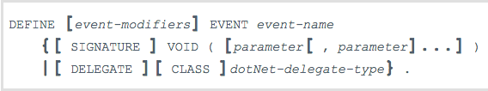
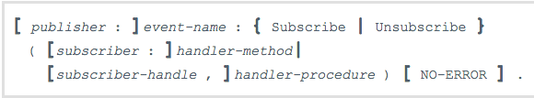
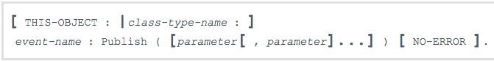
Observer
The observer pattern is a software design pattern in which an object, called the subject, maintains a list of its dependents, called observers, and notifies them automatically of any state changes, usually by calling one of their methods
OpenEdge has Publish and Subscribe built-in for Procedural and OO coding

Slide 55
Observer — Exercise
See Exercises folder, exercise 16

Slide 56
Mediator
Encapsulates communication between objects
Competes with Observer
But …. less reusable
Could be used as a way to ensure communication with Observers (like a service bus)

Slide 57
State
The State pattern is a solution to the problem of how to make behavior depend on state
We can use it to make a Finite State Machine: an abstract machine that can be in exactly one of a finite number of states at any given time.
Consists of:
A ‘context’ class
A State abstract class
Concrete classes for the different states, these hold state-specific behavior
The ‘context’ class holds a pointer to the current state, also used for changing state
State changes are fired via Actions

Slide 58
State — Exercise
See Exercises folder, exercise 17

Slide 59
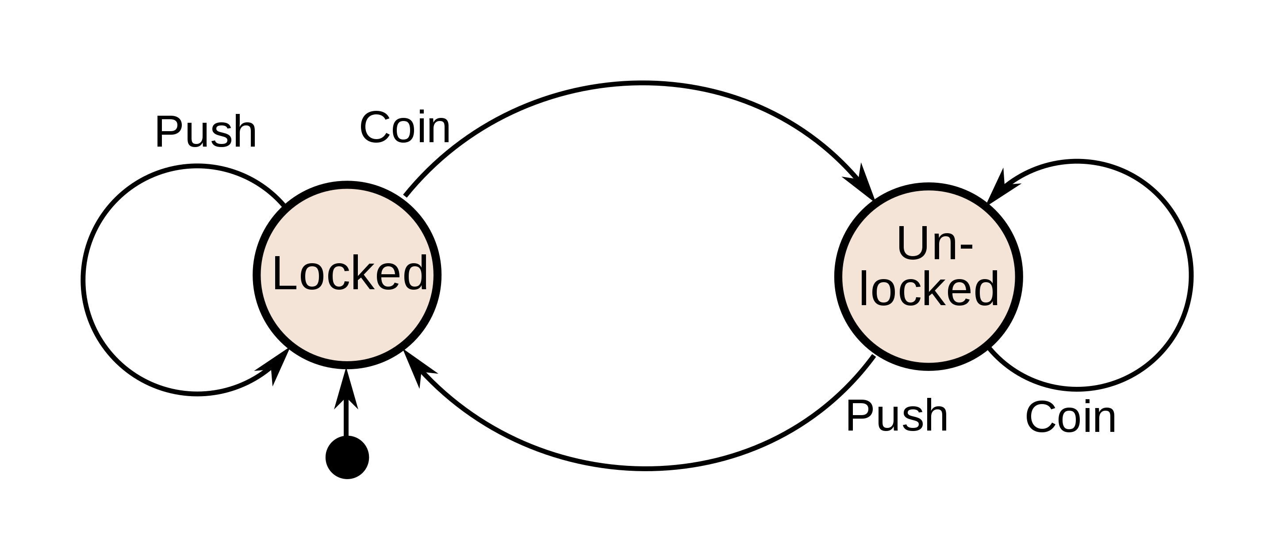
State — Bonus Exercise
Design and implement a set of classes to manage turnstiles
A turnstile has two states: Locked and Unlocked
It support two actions: Push and Coin
Define the State class as abstract so action methods can be overridden (or not) — this will allow invalid actions to be performed without causing pointer errors

Slide 60
Strategy — Exercise
See Exercises folder, exercise 4

Slide 61
Template Method
Used to implement the invariant parts of an algorithm once and allow subclasses implement the behavior that can vary
Useful for common classes that generalize behavior to avoid code duplication
How: create an abstract class that implements methods with invariable logic and defines the abstract methods for the variable logic
E.g. “hook” operations
E.g. refactoring to generalize — Opdyke and Johnson

Slide 62
Template Method — Exercise
See Exercises folder, exercise 4

Slide 63
Visitor
Visitor pattern allows a class to defer operations to a separate class which “visits” it back for properties and methods
The operation executed depends on: the name of the request, and the type of TWO receivers (the type of the Visitor and the type of the element it visits)
Configured by Visitor interface with concrete visitors and a Visitable interface used by classes that need to be visited
Useful for complex object structures regardless of type or hierarchy e.g. can be used when traversing tree view object structures or collections
The actual logic will be implemented within the concrete visitor classes — on behalf of the visited classes
Clients will specify which concrete visitor class (object) to use to visit certain elements
Visitor relies on double dispatch mechanism to achieve its “visiting” goal: accept/visit
Element objects “accept” a concrete visitor which in turn calls the “visit” method within the visitor passing itself along — double dispatch

Slide 64
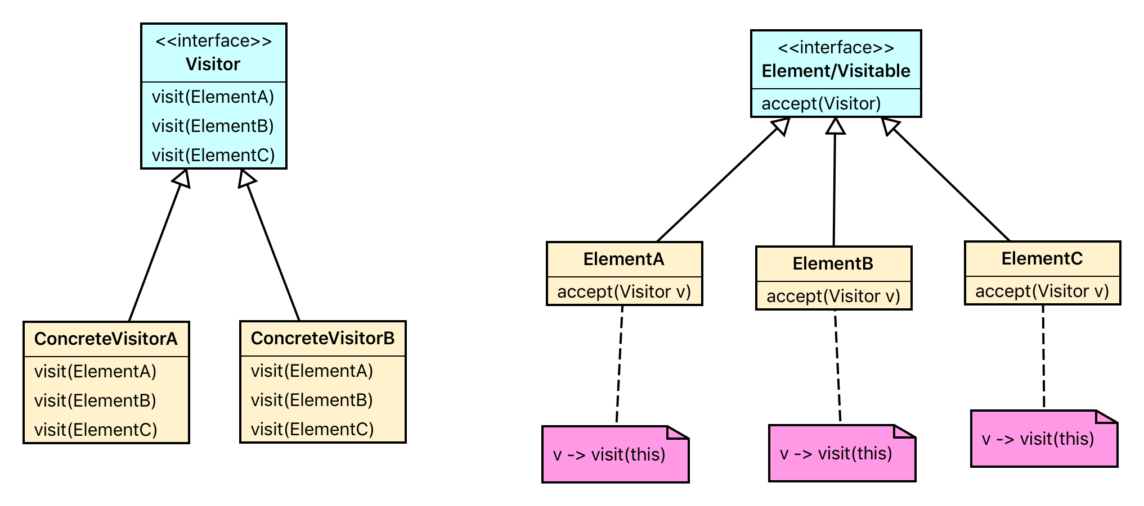
Visitor — Class Diagram

Slide 65
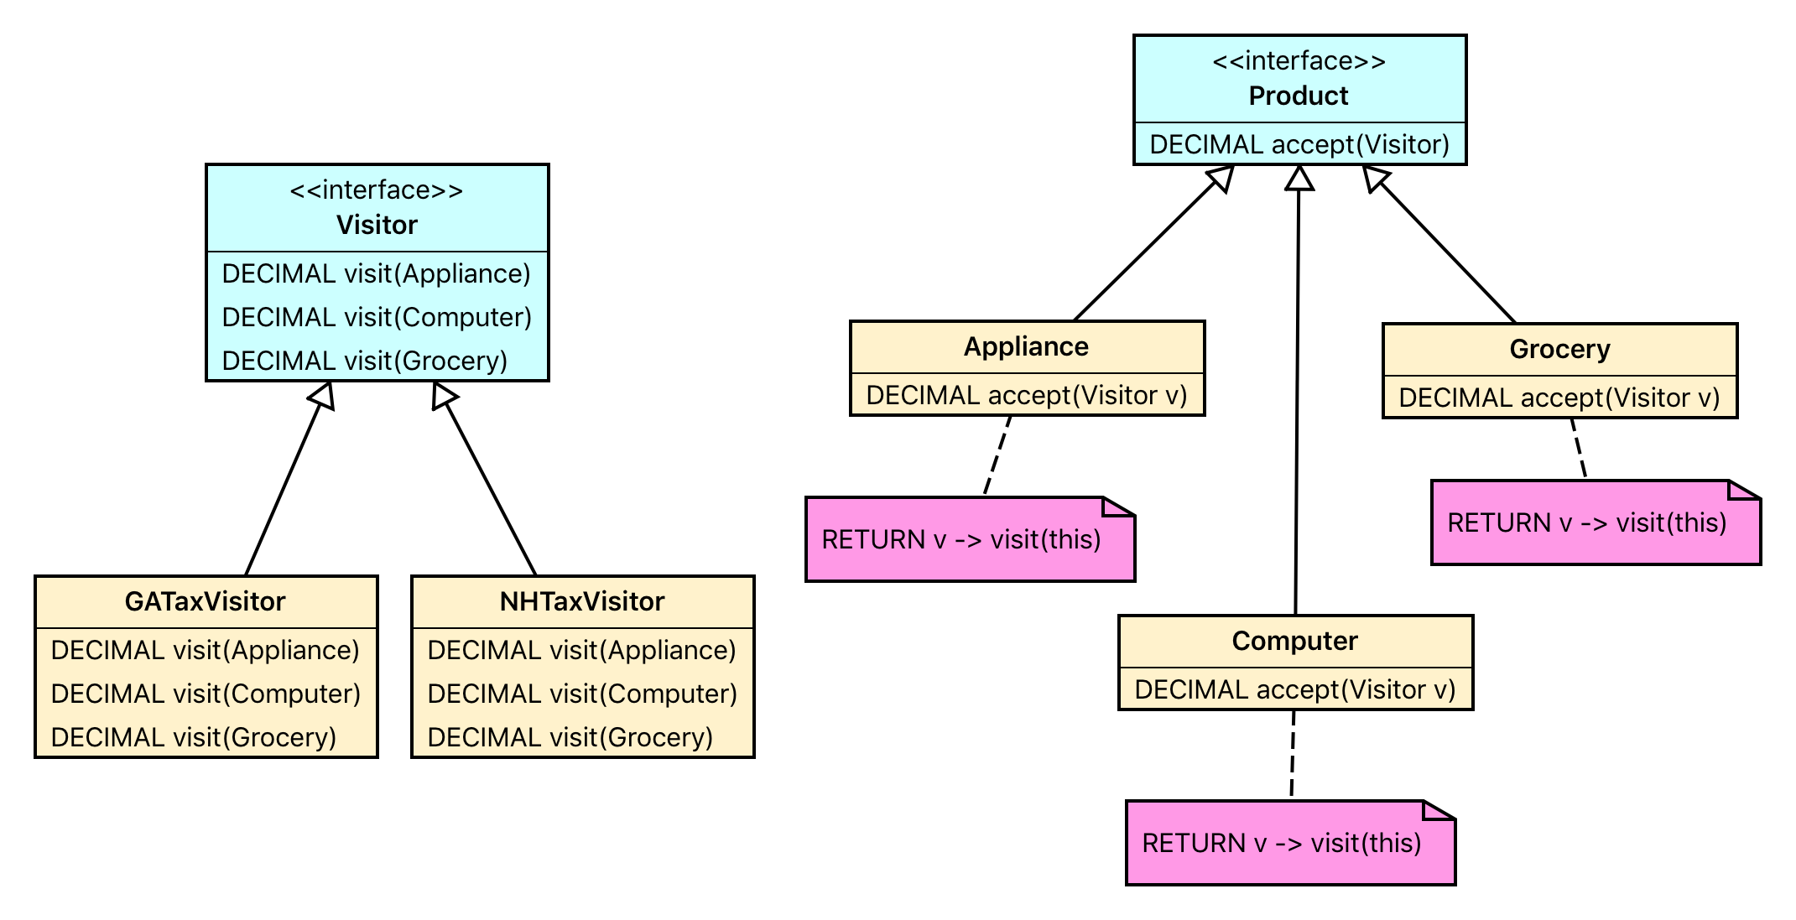
Visitor — Exercise Class Diagram

Slide 66
Visitor — Exercise Client (Test)
DEFINE VARIABLE taxCalc AS TaxVisitor NO-UNDO.
DEFINE VARIABLE prod1 AS Product NO-UNDO.
DEFINE VARIABLE prod2 AS Product NO-UNDO.
DEFINE VARIABLE prod3 AS Product NO-UNDO.
DEFINE VARIABLE total1 AS DECIMAL NO-UNDO.
DEFINE VARIABLE total2 AS DECIMAL NO-UNDO.
DEFINE VARIABLE total3 AS DECIMAL NO-UNDO.
ASSIGN
taxCalc = NEW GATaxVisitor()
prod1 = NEW Grocery("Milk",3,5)
prod2 = NEW Appliance("Refrigerator",1,1500)
prod3 = NEW Computer("iMac",1,1200)
total1 = prod1:accept(taxCalc)
total2 = prod2:accept(taxCalc)
total3 = prod3:accept(taxCalc).
MESSAGE prod1:productName STRING(total1,"$>>>,>>9.99") VIEW-AS ALERT-BOX.
MESSAGE prod2:productName STRING(total2,"$>>>,>>9.99") VIEW-AS ALERT-BOX.
MESSAGE prod3:productName STRING(total3,"$>>>,>>9.99") VIEW-AS ALERT-BOX.

Slide 67
Progress OpenEdge resources
Web site
https://www.progress.com/openedge
YouTube channel
https://www.youtube.com/channel/UCNxy1VY73tYJ7o_R25HjohQ/playlists?shelf_id=10&view=50&sort=dd
Documentation
http://documentation.progress.com/output/ua/OpenEdge_latest/
Technical support and knowledge base
https://www.progress.com/support/reference-guide
Developer community
https://community.progress.com
Progress eLearning community
https://wbt.progress.com

